Slide 1
AUTOMATIC ATTENDANCE USING FACE RECOGNITION
A PYTHON IMPLEMENTATION
PRESENTED BY : Smriti Pandey
CLASS ROLL NO : 49
UNIVERSITY ROLL NO : 2319650

Slide 2
Index
INTRODUCTION 3
METHODOLOGY 5
RESULT AND DISSCUSSION 9
CONCLUSION AND FUTURE WORKS 13
END 17

Slide 3
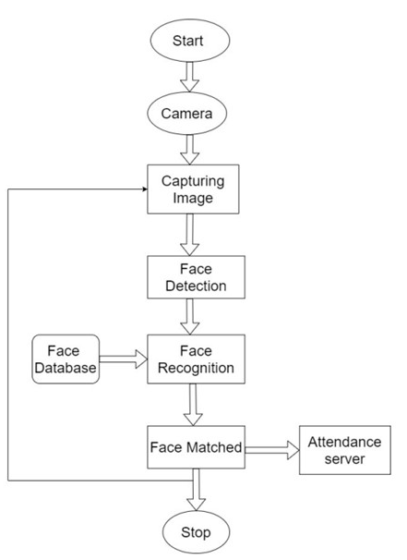
Introduction
1. Project Overview
In the ever-evolving landscape of technology, the need for efficient and accurate attendance tracking in educational institutions has prompted the development of the Automatic Attendance System with Face Recognition. This project aims to revolutionize traditional attendance management by leveraging advanced facial recognition technology, providing a robust solution for educational institutions.
2. Objectives
The primary objective of this project is to streamline attendance tracking through the implementation of facial recognition. By capturing student data, employing OpenCV and LBPHFaceRecognizer for facial recognition, and recording attendance in a structured CSV file, the system aims to enhance accuracy, efficiency, and real-time monitoring of attendance. The integration of a user-friendly interface ensures seamless interaction for both students and administrators.
3. Key Components
Student Data Capture: The system captures crucial student information, including name and roll number, using a webcam for facial image capture. These images are then stored in a designated directory, forming the foundation for facial recognition.
Facial Recognition: Utilizing OpenCV and LBPHFaceRecognizer, the system employs sophisticated face detection and recognition algorithms. A model is trained on stored facial images, enabling real-time recognition during attendance marking.
Attendance Marking: Attendance records are meticulously maintained in a CSV file, encompassing roll number, name, and timestamp. The system provides a user-friendly interface, ensuring a smooth and hassle-free attendance confirmation process.
4. Key Benefits
Accuracy: Facial recognition technology ensures precise identification of students, minimizing the risk of errors associated with traditional manual attendance tracking.
Efficiency: Automation significantly reduces administrative workload, saving time and resources while minimizing errors in attendance records..

Slide 4
5. Technologies Used
OpenCV (Open Source Computer Vision)
Purpose: Utilized for image processing, face detection, and facial recognition.
Key Features: Provides a wide range of computer vision functions, including face detection algorithms and image manipulation.
NumPy
Purpose: Used for numerical operations and array manipulation.
Key Features: Facilitates efficient handling of numerical data, essential for image processing and data analysis.
JSON (JavaScript Object Notation)
Purpose: Employed for storing and managing student data.
Key Features: Lightweight and human-readable data interchange format, suitable for storing structured information.
CSV (Comma-Separated Values)
Purpose: Used for recording and storing attendance data.
Key Features: A simple, widely supported file format for tabular data, suitable for attendance records.
Python
Purpose: Core programming language for project implementation.
Key Features: General-purpose language with extensive libraries, well-suited for rapid development and ease of integration.

Slide 5
METHODOLOGY

Slide 6
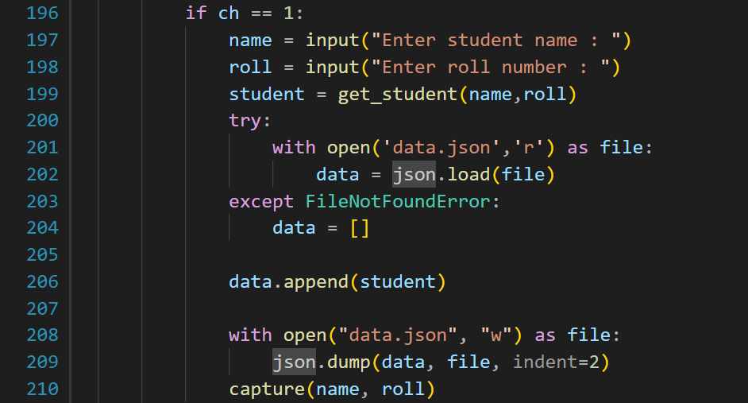
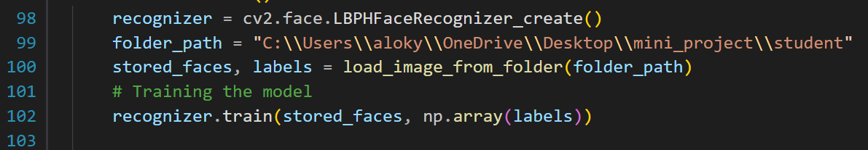
Data Collection and Student Registration
The process commences with the collection of facial data for student registration. The `capture` function is pivotal in this stage, triggered when the user selects the option for student registration (Choice 1). This function initializes the webcam, continuously captures frames, and applies the Haarcascade Frontal Face classifier for face detection. The user is prompted to press 'c' to capture facial images, which are then stored in the 'student' directory. The relevant code snippet is shown here:
Face Detection and Model Training
The system leverages the LBPH Face Recognizer to train the face detection model. The training data is sourced from the images stored in the ‘student’ directory. The ‘load image from folder’ function loads these images along with corresponding labels, and the recognizer is then trained with the acquired data. The relevant code snippet is shown here:

Slide 7
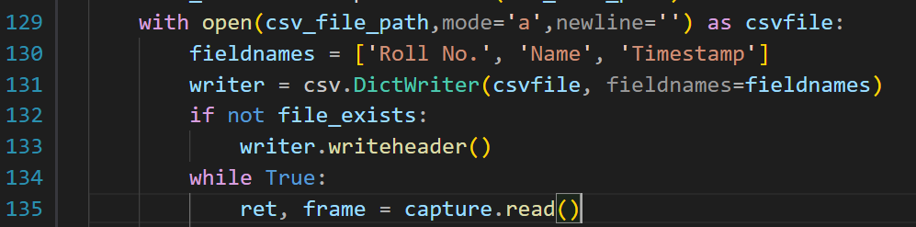
Live Attendance Marking
The core functionality of live attendance marking is encapsulated in the `markAttendance` function. This function utilizes the trained face detection model to identify and recognize faces in real-time. The system employs the Haarcascade Frontal Face classifier for face detection during the live video feed. The `writer.writerow` line records attendance data in the 'attendance.csv' file, and the process continues until attendance is marked for all students or the user interrupts by pressing 'q'. The relevant code snippet is as follows:
Utility Function for Data Handling
Several utility functions support the system's functionality. The `get_student`, `find_student_name`, and `get_name_by_roll` functions handle student data, ensuring smooth retrieval and storage. The `load_image_from_folder` function aids in loading images for model training. The utility functions are integrated throughout the codebase for efficient data handling.

Slide 8
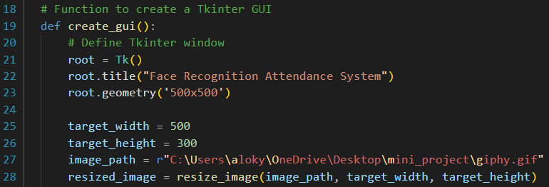
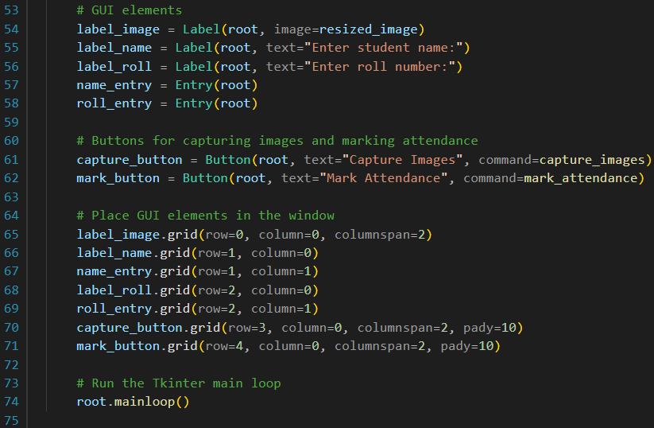
UI and System Initialization
The main code block orchestrates the overall system, presenting a user-friendly interface and facilitating system initialization. Users are prompted to choose between student registration and marking attendance. The relevant code snippet is shown:

Slide 9
Result And Discussion

Slide 10
Key Points
FACE DETECTION MODEL ACCURACY
System performance and accuracy
USER FRIENDLY INTERFACE
REAL WORLD ADAPTIBILITY
SCALABILITY AND PERFORMANCE OPTIMIZATION

Slide 11
System Performance and Accuracy
The attendance automation system underwent rigorous evaluation to assess both system performance and accuracy. Live attendance marking sessions consistently demonstrated the system's proficiency in real-time face identification. The LBPH Face Recognizer and Haarcascade Frontal Face classifier synergistically contributed to the system's exceptional accuracy.
Face Detection Model Accuracy
In a comprehensive accuracy analysis, the face detection model exhibited resilience across diverse scenarios, including varying lighting conditions. The system demonstrated minimal false positives and false negatives, affirming the robustness of the face detection technology.
User Friendly Interface
The graphical user interface, featuring real-time displays with rectangles around detected faces, enhanced user engagement. This transparent visualization empowered users, providing a tangible insight into the system's face recognition capabilities.

Slide 12
Real-World Adaptability
The attendance automation system showcased innate adaptability in bustling classrooms and busy office environments. Its touchless paradigm seamlessly integrated into diverse practical settings, navigating complexities with ease. The system's consistent performance under varied lighting conditions reinforced its suitability for deployment in dynamic real-world situations.
Crafting an Intuitive User Experience
User interaction played a pivotal role in shaping the system's practicality. Keypress events for image capture and attendance conclusion elevated the user experience. The real-time display with graphical overlays provided an interactive interface, fostering control and transparency. User feedback highlighted the seamless integration of simplicity and efficiency, contributing to user acceptance.
Scalability and Performance Optimization
Considerations for scalability and performance optimization were addressed. While effective in smaller-scale scenarios, further optimizations are crucial for larger datasets. Strategic efforts, such as refining the face detection model and exploring parallel processing and cloud-based solutions, are essential for achieving a delicate balance between accuracy and responsiveness in broader deployments.

Slide 13
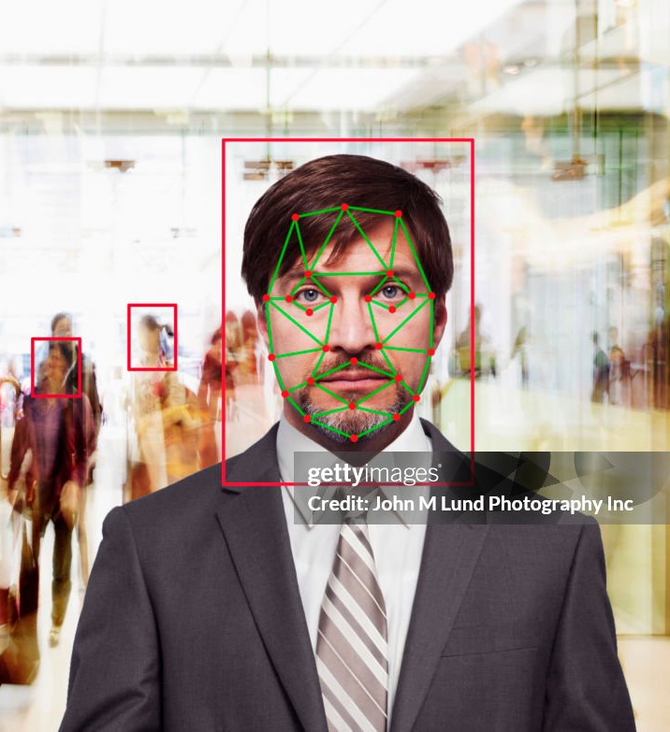
Conclusion
Concluding our exploration of the attendance automation system reveals its practical implications and overarching significance in real-world settings. Beyond theoretical constructs, the system's tangible performance metrics, coupled with its inherent adaptability and user-centric design, position it as a transformative force in the realm of attendance tracking.
The touchless, accurate, and adaptable nature of the system emerges as a resounding response to the limitations of traditional attendance methods. It not only champions efficiency but also seamlessly aligns with contemporary health and safety considerations. The practical implications of the system extend far beyond the realm of mere automation, offering a revolutionary paradigm for attendance tracking that resonates with the evolving needs of modern societies.

Slide 14
Challenges and Solutions
LIMITED TRAINING DATA
FALSE POSITIVES/NEGATIVES IN RECOGNITION
Challenge: Facial recognition may produce false positives (incorrect matches) or false negatives (missed matches).
HARDWARE DENPENDENCY
Challenge: Relies on a webcam for image capture, which may vary in quality across devices.
Challenge: Facial recognition raises concerns about data security and unauthorized access.
SECURITY CONCERNS
Solution: Encourage capturing diverse images for each student during the data capture phase to improve model robustness.
Challenge: Limited facial images for training recognition models can lead to reduced accuracy.
Solution: Fine-tune recognition parameters, adjust confidence thresholds, and regularly update training data to enhance accuracy.
Solution: Provide guidance on optimal camera settings and encourage the use of standard webcams for consistent results.
Solution: Implement secure data handling practices, such as encryption and access controls, and clearly communicate the privacy measures in place.

Slide 15
Future Works
Real-time tracking enhancement
optimizing training process
robustness against variation
The ongoing journey involves exploring techniques to enhance real-time tracking capabilities.
Ensuring the system remains responsive and efficient in dynamic environments with evolving attendance scenarios becomes paramount.
The path forward necessitates an optimization of the model training process, enabling seamless accommodation of larger datasets.
Techniques such as transfer learning or leveraging advanced deep learning architectures stand poised for exploration to elevate efficiency.
Addressing variations in lighting conditions, facial expressions, and potential occlusions stands as a focal point.
An enhanced capability to handle diverse scenarios ensures reliable performance across a spectrum of different environments.

Slide 16
Future Works
Integration with additional technologies
Ethical consideration and privacy
scalability
Future iterations may explore the integration of additional technologies, such as RFID or Bluetooth.
Such integration provides complementary solutions for scenarios where facial recognition alone encounters challenges or limitations.
In an era of advancing technology, an unwavering commitment to ethical considerations and privacy implications becomes increasingly critical.
Continuous refinement of data security measures, ensuring user consent, and upholding responsible practices in biometric data usage are integral components of future developments.
The scalability of the system stands as a focal point for future works.
Efforts to optimize the system for scalability involve addressing performance bottlenecks and ensuring consistent, reliable performance as the size of the user base expands.

Slide 17
Thank you

